Slide 1
J2EE
JSP TECHNOLOGY IN J2EE

Slide 2
Objectives
Enable the developer to create the website
Using the elements of Jsp
Understand the life cycle and utilize the flow of the
Jsp life cycle
Creating Common header and footer page
Configuring the list of webpages
Configuring the session time out through web.xml

Slide 3
Agenda
Describe JSP technology
Write JSP code using scripting elements
Write JSP code using the page directive
Configure the JSP environment in the web.xml file

Slide 4
Java Server Pages Technology
• Java Server Pages enable you to write standard HTML
pages containing tags that run powerful programs
based on Java technology.
• The goal of JSP technology is to support separation of
presentation and business logic:
• Web designers can design and update pages
without learning the Java programming language.
• Programmers for Java platform can write code
without dealing with web page design.

Slide 5
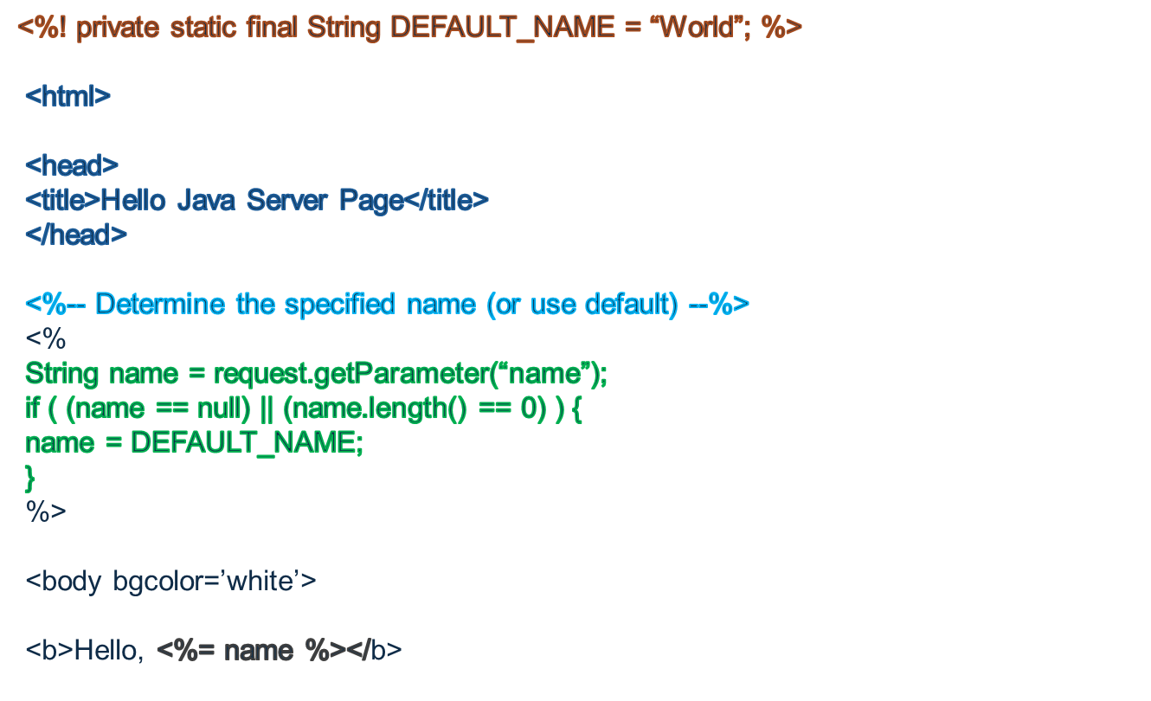
Sample Jsp Code

Slide 6
JSP LIFE Cycle
1.Translate the JSP to Ready servlet code
2. Compile the servlet to byte code.
3. Load the servlet class.
4. Create the servlet instance.
5. Call the jspInit method.
6. Call the _jspService method
7. Call the jspdestroy method.

Slide 7










JSP LIFE Cycle
JSP Page
Request
Translation by
JSP engine
Web
Client
Generated Servlet
Compilation
Compiled Servlet
Response
Instantiation
Servlet is loaded to
server

Slide 8







JSP API
javax.servlet.jsp.HttpJspPage
jspInit()
_jspService(request,response)
jspDestroy()
jspInit()
Initialise JSP
Invoked only once
_jspService(request,response)
Handle Requests:
invoked
for every request
jspDestroy()
Invoked by
container
to cleanup

Slide 9






Hypertext Transfer Protocol
Hello.jsp
Hello_jsp.jsp
Translate
User request
Compile
Web container
Hello_jsp.class
Loads
Create ins
Call jspInit()
Webserver

Slide 10




Hypertext Transfer Protocol
Hello.jsp
Hello_jsp.jsp
Translate
User request
_jspService
Compile
Web container
Hello_jsp.class
Loads
Call jspInit()
Create ins
Webserver

Slide 11



Hypertext Transfer Protocol
Webserver
Hello.jsp
Hello_jsp.jsp
Translate
User request
_jspService
Web container
Compile
jspDestroy
Hello_jsp.class
Loads
Create ins
Call jspInit()
Webserver

Slide 12
Scripting Elements in JSP
There are five types of scripting elements:
Scripting Element Scripting Syntax
Comment <%-- comment --%>
Directive <%@ directive %>
Declaration <%! decl %>
Scriplet <% code %>
Expression <%= expr %>

Slide 13
Directive and Declarative Tag
Directive Tag
A directive tag affects the JSP page translation phase.
<%@ page session=”false” %>
<%@ include file=”incl/copyright.html” %>
Declaration Tag
A declaration tag lets the JSP page developer include
declarations at the class-level.
<%! public static final String DEFAULT_NAME = “World”; %>
<%! public String getName(HttpServletRequest request)
{
return request.getParameter(“name”);
}
%>

Slide 14
Scriptlet Tag
Scriptlet Tag
A scriptlet tag lets the JSP page developer include arbitrary
Java technology code in the _jspService method.
<% int i = 0; %>
<% if ( i > 10 )
{
%>
I is a big number.
<% } else { %>
I is a small number
<% } %>

Slide 15
Expression Tag
Expression Tag
An expression tag encapsulates a Java technology runtime
expression, the value of which is sent to the HTTP response
stream.
<B>Ten is <%= (2 * 5) %></B>
Thank you, <I><%= name %></I>, for registering for the soccer league.
The current day and time is: <%= new java.util.Date() %>

Slide 16
Implicit Variables
These variables are predefined in the _jspService method.
Variable Name | Description
request | The HttpServletRequest object associated with the Request
response | The HttpServletResponse object associated with the response that is sent back to the browser.
out | The JspWriter object associated with the output stream of the response.
session | The HttpSession object associated with the session for the given user of the request. This variable is only meaningful if the JSP page is participating in an HTTP session.

Slide 17
Implicit Variables
Variable Name | Description
Application | The ServletContext object for the web application.
config | The ServletConfig object associated with the servlet for this JSP page.
pageContext | The pageContext object encapsulates the environment of a single request for this JSP page.
page | The page variable is equivalent to the this variable in the Java programming language.
exception | The Throwable object that was thrown by some other JSP page. This variable is only available in a JSP error page.

Slide 18
Page Directive
The page directive is used to modify the overall translation of
the JSP page.
• You can have more than one page directive, but can
only declare any given attribute once (the import
attribute is the one exception).
• You can place a page directive anywhere in the JSP file.
It is a good practice to make the page directive the first
statement in the JSP file.
The page directive defines a number of page-dependent
properties and communicates these to the web container at
translation time.

Slide 19
Page Directive
Attribute | Use
language | This tells the server that the page is using the java language. Current JSP specification supports only java language. Example: <%@page language="java" %>
extends | Defines the (fully-qualified) class name of the superclass of the servlet class that is generated from this JSP page. Do not use this attribute. Example: <%@page language="java" import="java.sql.*,mypackage.myclass" %>
buffer | Defines the size of the buffer used in the output stream (a JspWriter object). The value is either none or N kb.The default buffer size is 8 KB or greater. For example: buffer=”8kb” or buffer=”none”
Autoflush | Defines whether the buffer output is flushed automatically when the buffer is filled or whether an exception is thrown. The value is either true (automatically flush) or false (throw an exception). The default is true.

Slide 20
Page Directive
Attribute | Use
Session | Defines whether the JSP page is participating in an HTTP session. The value can be either true (the default) or false. Example: <%@page language="java" session="true" %>
Import | Defines the set of classes and packages that must be imported in the servlet class definition. The value of this attribute is a comma-delimited list of fully-qualified class names or packages.(ex : import=”java.sql.Date,java.util.*,java. Text.*”)
isThreadSafe | Allows the JSP page developer to declare whether or not the JSP page is thread-safe.
Info | Defines an informational string about the JSP page. contentType Example <%@ info=“This is my first page” %>
contentType | Defines the MIME type of the output stream. The default is text/html. Example : : <%@page language="java" session="true" contentType="text/html;charset=ISO-8859-1" %>

Slide 21
Page Directive
Attribute | Use
pageEncoding | Defines the character encoding of the output stream. The default is ISO-8859-1.
isELIgnored | Specifies whether EL elements are ignored on the page. The value is either true or false (default). If set to true, EL on the page is not evaluated.
isErrorPage | Defines that the JSP page has been designed to be the target of another JSP page’s errorPage attribute. <%@page isErrorPage=true %>
errorPage | errorPage is used to handle the un-handled exceptions in the page. Example: <%@page language="java" session="true" errorPage="error.jsp" %>

Slide 22
Prelude-coda
The <include-prelude> and <include-coda> elements automatically include a page before and after the evaluation of a group of pages. The <include-prelude> element is a context-relative path that must correspond to an element in the web application. When the element is present, the given path will be automatically included (as in an include directive) at the beginning of each JSP page in this <jsp-property-group>.
The <include-coda> element is a context-relative path that must correspond to an element in the web application. When the element is present, the given path will be automatically included (as in an include directive) at the end of each JSP page in this <jsp-property-group>. The following fragment shows a file being included at the start and end of every JSP page in the web application:

Slide 23
Prelude-coda configuration
<jsp-config>
<jsp-property-group>
<url-pattern>*.jsp</url-pattern>
<include-prelude>/header.jsp</include-prelude>
<include-coda>/footer.jsp</include-coda>
</jsp-property-group
</jsp-config>

Slide 24
Tags in jsp
Why Tags in jsp
You can use tags in JSP pages rather than the scriptlet code
The mixing of scriptlet and HTML code is also hard for computers to read.
By using the tags we can separate the business logic and the presentation logic seperatly

Slide 25
Action Tags in JSP
    The action tags basically are used to control the flow between pages and to use Java Bean.
    Jsp action tags used to reduce the java coading in jsp page
    Jsp action tags are as follows:
jsp:forward
jsp:include
jsp:useBean
jsp:setProperty
jsp:getProperty
jsp:plugin
jsp:param
jsp:fallback

Slide 26
Action Tags in JSP
<jsp:forward page="relativeURL | <%= expression %>">
<jsp:param name="parametername" value="parametervalue | <%=expression%>" />
</jsp:forward>
<html>
<body>
<h2>this is index page</h2>
<jsp:forward page="printdate.jsp" >
<jsp:param name="name" value="javatpoint.com" />
</jsp:forward>
</body>
</html>

Slide 27
Action Tags in JSP
<jsp:include page="relativeURL | <%= expression %>" />
<html>
<body>
<h2>this is index page</h2>
<jsp:include page="printdate.jsp" />
<h2>end section of index page</h2>
</body>
</html>

Slide 28
Action Tags in JSP
<jsp:useBean id= "instanceName" scope= "page | request | session | application"
class= "packageName.className" type= "packageName.className"
beanName="packageName.className | <%= expression >" >
</jsp:useBean>
<jsp:useBean id="obj" class="com.javatpoint.Calculator"/>
<%
int m=obj.cube(5);
out.print("cube of 5 is "+m);
%>

Slide 29
Action Tags in JSP
<jsp:setProperty name="instanceOfBean" property= "*" |
property="propertyName" param="parameterName" |
property="propertyName" value="{ string | <%= expression %>}"
/>
<jsp:setProperty name="bean" property="username" />
<jsp:setProperty name="bean" property="username" value="Kumar" />
or
<jsp:setProperty property="*" name="userinfo"/>

Slide 30
Action Tags in JSP
<jsp:getProperty property="propertyname" name="userinfo"/>
<jsp:getProperty property="age" name="userinfo" /><br>
<jsp:getProperty property="username" name="userinfo"/><br> <jsp:getProperty property="password" name="userinfo"/><br>

Slide 31
Action Tags in JSP
<jsp:plugin
type="applet"
code="net.codejava.applet.MyApplet.class"
codebase="html">
<jsp:params>
<jsp:param name="username" value="Tom" />
</jsp:params>
<jsp:fallback>
<p>Could not load applet!</p>
</jsp:fallback>
</jsp:plugin>

Slide 32


Slide 33
Quiz
Choose the statement that best describes the relationship between JSP and servlets:
A. Servlets are built on JSP semantics and all servlets are compiled to JSP pages for runtime usage.
B. JSP and servlets are unrelated technologies.
C. Servlets and JSP are competing technologies for handling web requests. Servlets are being superseded by JSP, which is preferred. The two technologies are not useful in combination.
D. JSPs are built on servlet semantics and all JSPs are compiled to servlets for runtime usage.

Slide 34
Quiz
2. What alternatives exist to embedding Java code directly within the HTML markup of your JSP page?
A. Moving the code into your session manager.
B. Moving the code into scriptlets.
C. Moving the code into JavaBeans and servlets.
D. Moving the code into a transaction manager.

Slide 35
Quiz
3) javaserver pages are processed by
a) Jsp container
b) The asp.dll component
c) IIS
d) Web server
4) What is the output of the following code
<% session.setAttribute("name","John");%>
<%=session.getAttribute("name")%>
a) John
b)null
5)which one the following is a valid argument for a jsp page directive
a)caching="sizeb|none"
b)isThreadSafe="yes|no"
c)importer="package.class"
d)contentType="text/html"

Slide 36
Quiz
6)JSP are processed by software on the ?
a)server
b)client
7) The method _jspService of HttpJspPage should not be overriden by a JSp author
a)False
b)True
8)which of the following are legal attributes of a page directive
a)include
b)scope
c)errorpage
d)exception

Slide 37
Quiz
9) The methods JspInit and Destroy can be override by developer
a)true
b)False

Slide 38
Thank you

